Slide 1
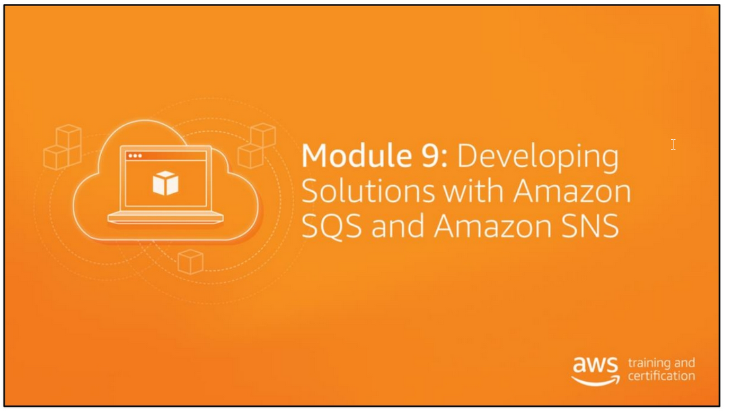

Slide 2
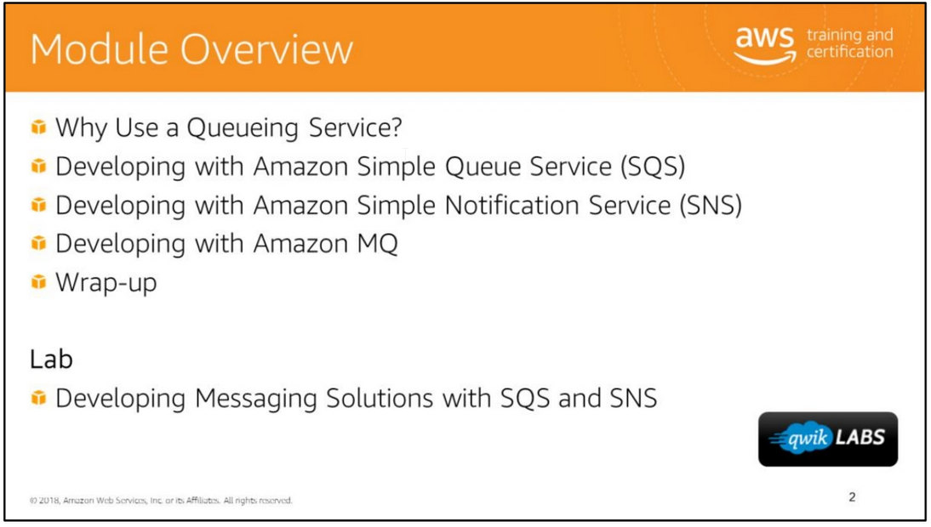

Slide 3
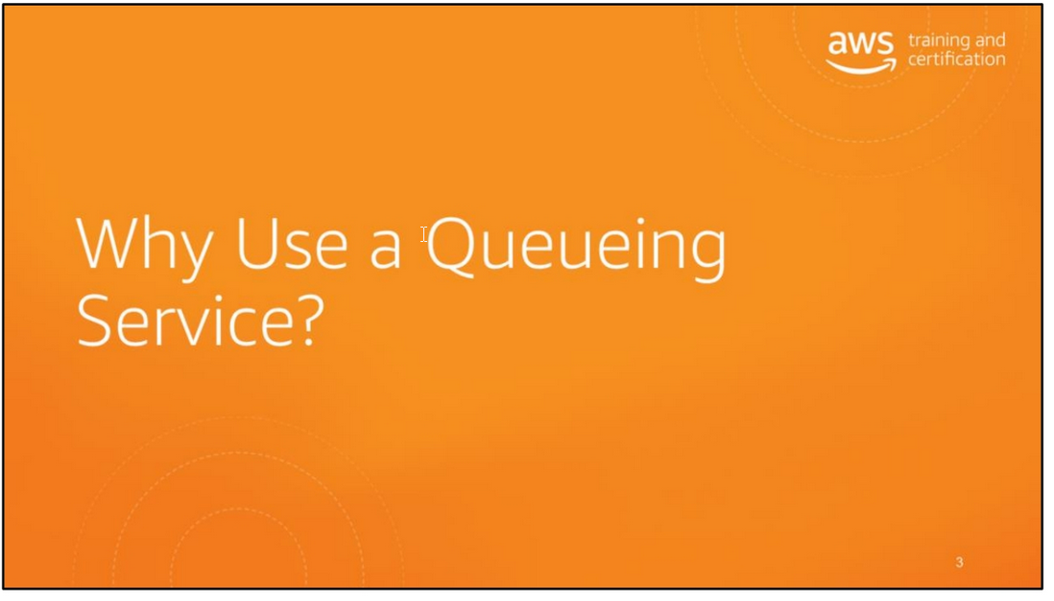

Slide 4
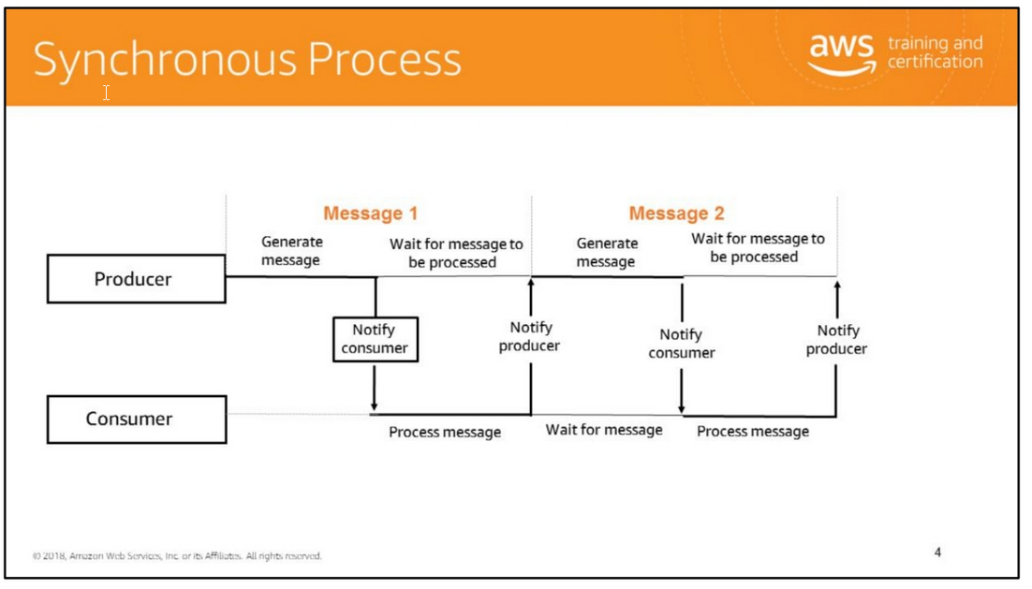
Consider a scenario where an application produces messages that must be processed by a consumer downstream.
The producer needs to know how to connect to the consumer. If the consumer fails for some reason, then messages may be lost.
If new consumer instances are launched to recover from failure or to keep up with an increased workload, the producer needs to be explicitly made aware of the new consumer instances.
In this scenario, the producer is tightly coupled with the consumers and the coupling is prone to brittleness.
Looking at the following example we have a producer and a consumer.
The producer generates a message, notifies the consumer, and waits for the message to be processed by the consumer.
The consumer processes the message and when done, notifies the producer, and waits for the next message.
As you can see, this is a very dependent process where there is a strong interdependency between the consumer and the producer, which is a tightly coupled system.

Slide 5
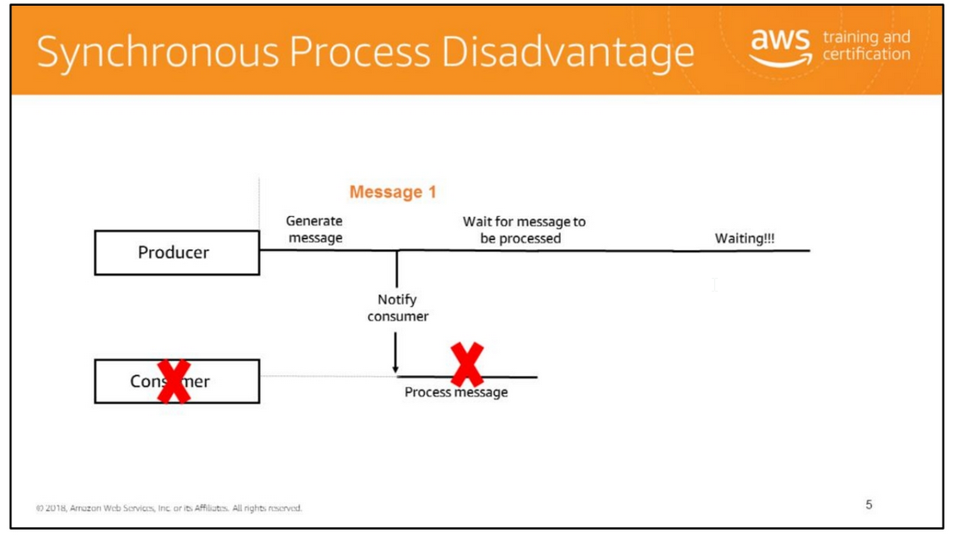
This interdependency creates a tightly coupled system.
The disadvantage with a tightly coupled system is that it is not fault tolerant.
If any one component in our system fails, the entire system will fail.
Should our consumer fail while processing the message the producer will be forced to wait and wait for the message to be processed,and will still be waiting.
Because of the tighly coupled nature of our system it is not fault tolerant

Slide 6
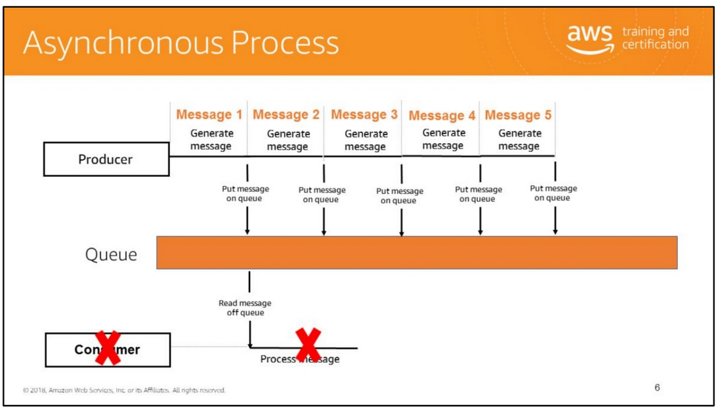
Having a queue service decouples the producer from the consumer. A queue is a temporary repository for messages that are awaiting processing.
It acts as a buffer between the component producing data and the component receiving the data for processing.
This means that the queue resolves issues that arise if the producer is producing messages faster than the consumer can process or if the producer or consumer are
only intermittently connected to the network.
A queue supports multiple producers and consumers interacting with the same queue.
A single queue can be used simultaneously by many distributed application components, with no need for those components to coordinate with each other to share the queue.
A queue delivers each message at least once.
Here is an example of an asynchronous process. Where you have a producer, a message queue, and a consumer. The producer generates a message and puts in onto the queue.
The producer then generates another message and puts it onto the queue. The producer does not have to wait for the first message to be read and processed before putting
the second message on the queue. Instead the producer can keep putting messages on the queue regardless if they are being read by the consumer or not.
When the consumer does read a message off the queue and starts processing it, if this consumer fails, it does not impact on the producer.
The producer can continue putting messages on the queue. This solution is far more loosely coupled and as a result has greater fault tolerance.

Slide 7
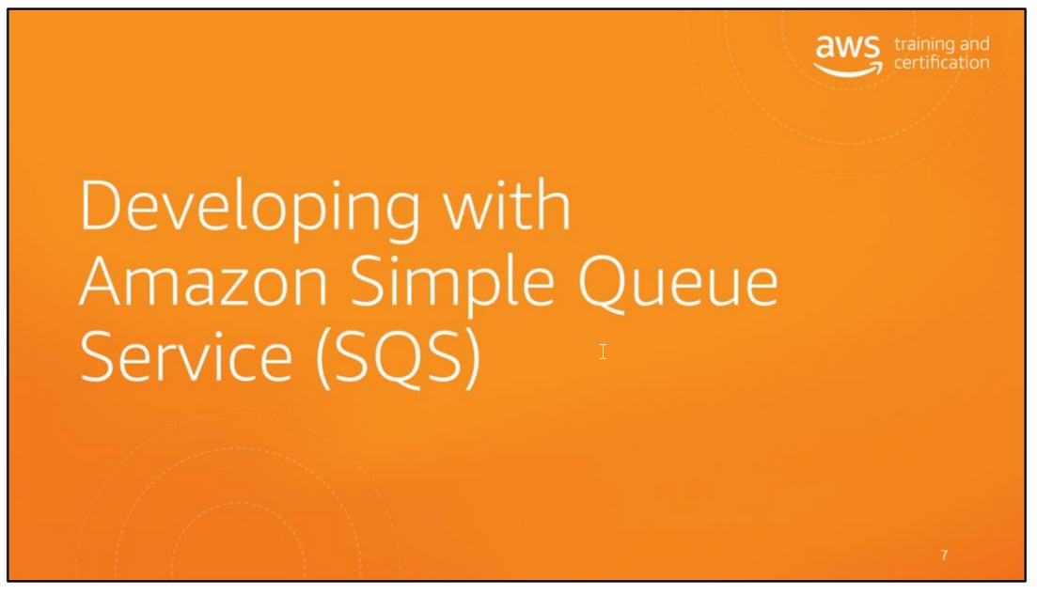

Slide 8
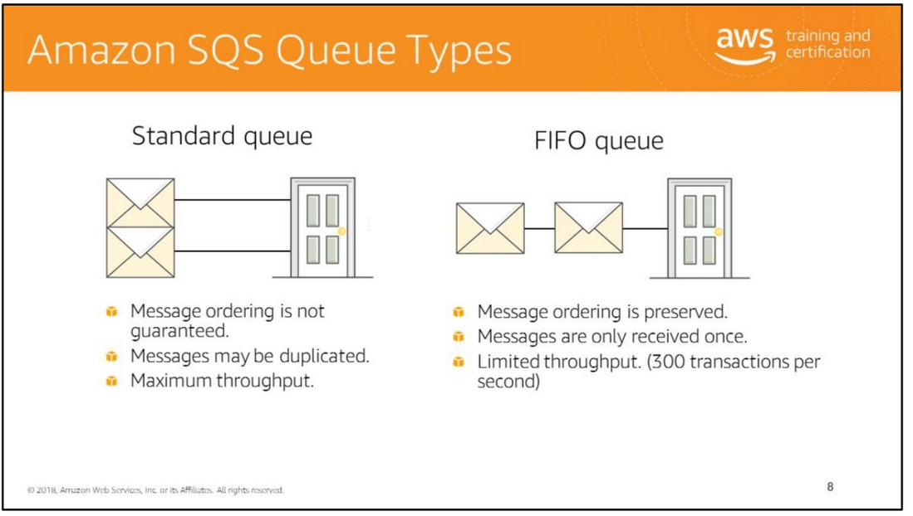
Standard queues support at-least-once message delivery. However, occasionally because of the highly-distributed architecture, more than one copy of a message might be delivered out of order.
Standard queues provide best-effort ordering which ensures that messages are generally delivered in the same order as they're sent.
You can use standard message queues in many scenarios, as long as your application can process messages that arrive more than once and out of order.
For more information see
http://docs.aws.amazon.com/AWSSimpleQueueService/latest/SQSDeveloperGuide/st andard-queues.html.
FIFO queues (First-In-First-Out) are designed to enhance messaging between applications when the order of operations and events is critical, or where duplicates can't be tolerated.
FIFO queues also provide exactly-once processing but are limited to 300 transactions per second (TPS).
FIFO queues are designed to enhance messaging between applications when the order of operations and events is critical.
For more information see http://docs.aws.amazon.com/AWSSimpleQueueService/latest/SQSDeveloperGuide/FI FO-queues.html.

Slide 9
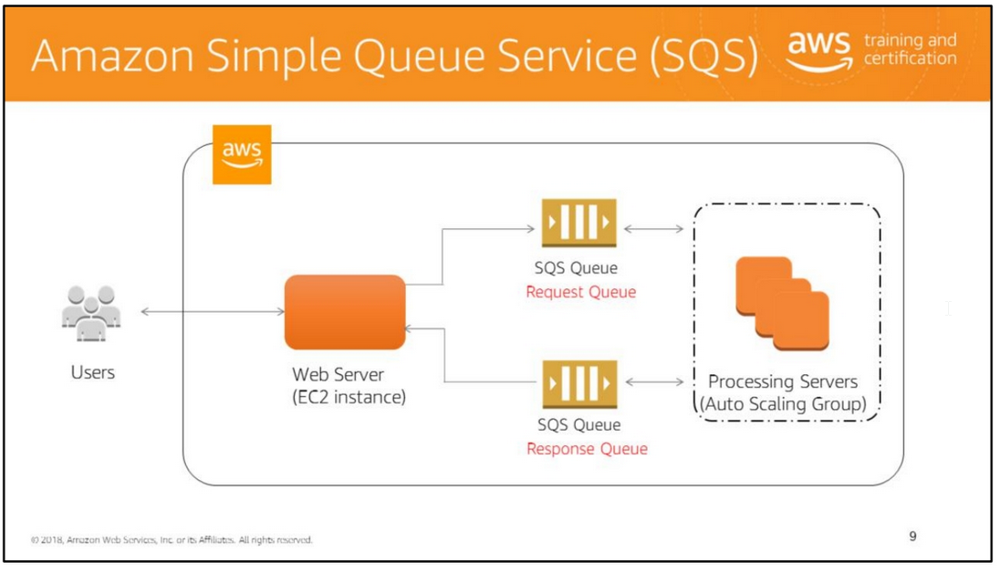
Amazon Simple Queue Service (SQS) is a web service that gives you access to a message queue that can be used to store messages while waiting for a computer to process them.
This allows you to quickly build message queuing applications that can be run on any computer on the Internet.
Amazon SQS helps developers focus on building sophisticated message-based applications, without worrying about how the messages are stored and managed.
Amazon SQS queues can deliver very high throughput (many thousands of messages per second). You can use Amazon SQS with software applications in various ways.
For example, you can:
• Integrate Amazon SQS with other AWS infrastructure web services to make applications more reliable and flexible.
• Use an Amazon SQS queue as a queue of work, where each message is a task that needs to be completed by a process.
One or many computers can read tasks from the queue and perform them.
• Have Amazon SQS help a browser-based application receive notifications from a server.
The application server can add the notifications to a queue, which the browser can poll—even if there is a firewall between them.
• Keep notifications of significant events in a business process in an Amazon SQS queue.
Each event can have a corresponding message in a queue, and applications that need to be aware of the event can read and process the messages.
Amazon SQS is engineered to always be available and deliver messages. A fast, reliable, scalable, fully managed message queuing service.
It allows for asynchronous communication, decouples components, supports higher throughput, and holds messages until you explicitly delete them.
For more information about throughput, see http://docs.aws.amazon.com/AWSSimpleQueueService/latest/SQSDeveloperGuide/t hroughput.html.

Slide 10
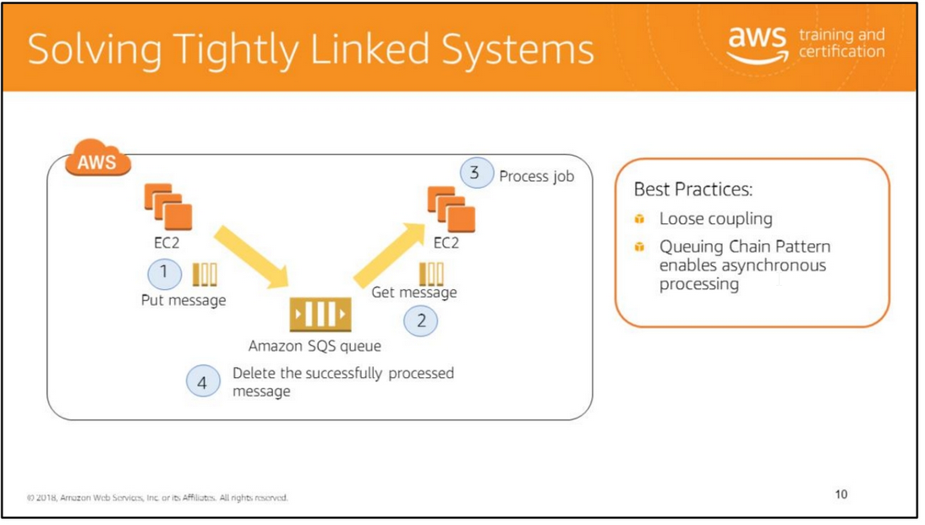

Slide 11
Queuing Chain Pattern is a cloud design pattern. For more information, see http://en.clouddesignpattern.org/index.php/CDP:Queuing_Chain_Pattern.
Problem to be solved
An example of image processing: the sequential operations of uploading, storing, and encoding the image, creating a thumbnail, and copyrighting are tightly linked to each other.
This tight linkage complicates the recovery operations when there has been a failure.
Queuing Chain Pattern
You can achieve loose coupling of systems by using queues between systems and exchanging messages that transfer jobs. This enables asynchronous linking of systems.
This method lets you increase the number of virtual servers that receive and process the messages in parallel.
If there is no image to process, you can configure auto scaling to terminate the servers that are in excess.
Although you can use this pattern without cloud technology, the queue itself is provided as an AWS cloud service (Amazon SQS), which makes it easier for you to use this pattern.
Benefits
• Use asynchronous processing to return responses quickly.
• Structure the system through loose coupling of Amazon EC2 instances.
• Handle performance and service requirements through merely increasing or decreasing the number of Amazon EC2 instances used in job processing.
• Even if an Amazon EC2 instance fails, a message remains in the queue service, which enables processing to be continued immediately upon recovery of the Amazon EC2 instance
and producing a system that is resistant to failure.

Slide 12
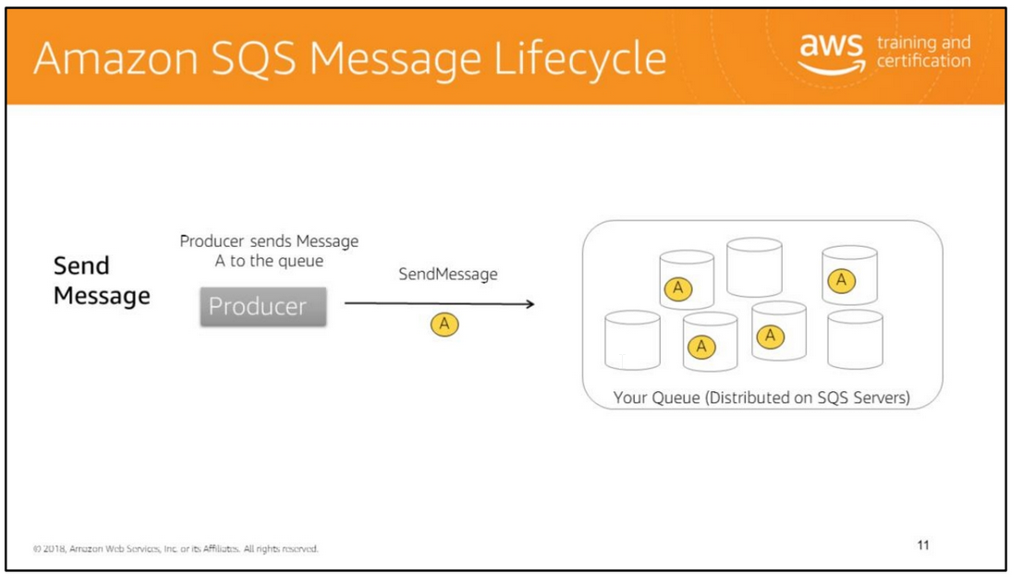
Immediately after a message is received, it remains in the queue. To prevent other consumers from processing the message again, Amazon SQS sets a visibility timeout,
a period of time during which Amazon SQS prevents other consumers from receiving and processing the message.
The default visibility timeout for a message is 30 seconds. The maximum is 12 hours.

Slide 13
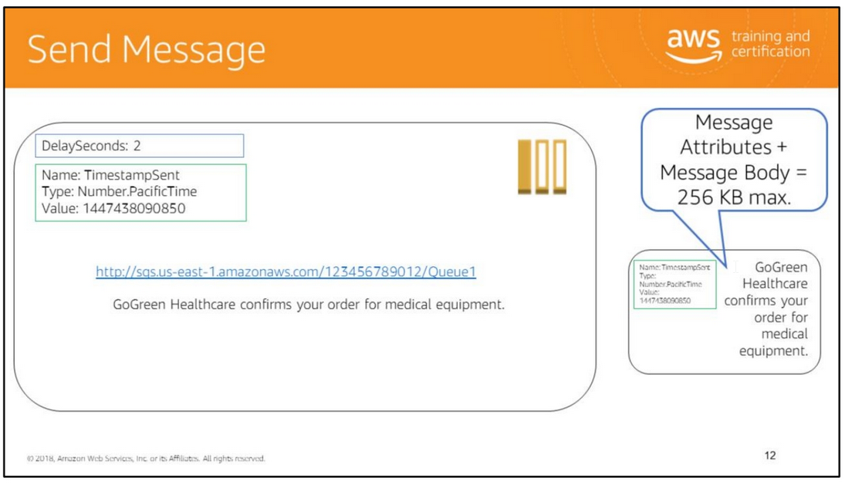

Slide 14
The SendMessage operation sends messages to a specific queue. The maximum message size is 256 KB.
The parameters of a SendMessage operation are as follows:
• QueueUrl (required): Specifies the url of the queue that the message should be sent to.
• MessageBody (required): Specifies the message to send.
• DelaySeconds (optional): Specifies the number of seconds to delay a specific message.
Messages will become available for processing after the delay time is finished. If you do not specify a value, the default value for the queue applies.
• MessageAttributes (optional): Specifies structured metadata about the message such as timestamp, signature, and geospatial data. Each message attribute consists
of the attributes name, type, and value.
The supported message attribute data types are String, Number, and Binary.
You can also provide custom information on the type. For example, you might define custom type labels such as Binary.gif and Binary.png to indicate the type of binary data in a message.
The data type is case sensitive, and it can be up to 256 bytes long. Message attribute data types identify how message attribute values are handled by Amazon SQS.
For example, if the type is a number, Amazon SQS will validate that the attribute value is a number.
The message size includes all parts of the message attribute, including name, type, and value. For more information about message attributes,
see http://docs.aws.amazon.com/AWSSimpleQueueService/latest/SQSDeveloperGuide /SQSMessageAttributes.html#SQSMessageAttributes.DataTypes.
You can also perform a batch request to deliver up to ten messages using the SendMessageBatch request.
Use the Amazon SQS Extended Client Library for Java to send messages with a large payload of up to 2 GB. For more information,
see https://github.com/awslabs/amazon-sqs-java-extended-client-lib.

Slide 15
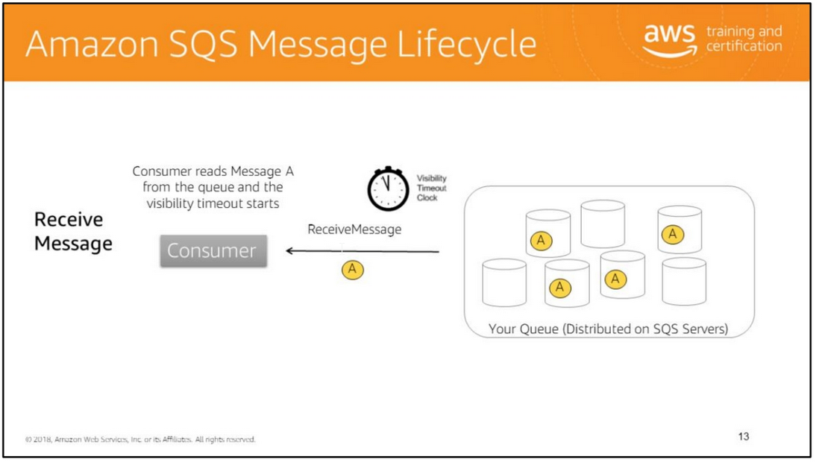

Slide 16
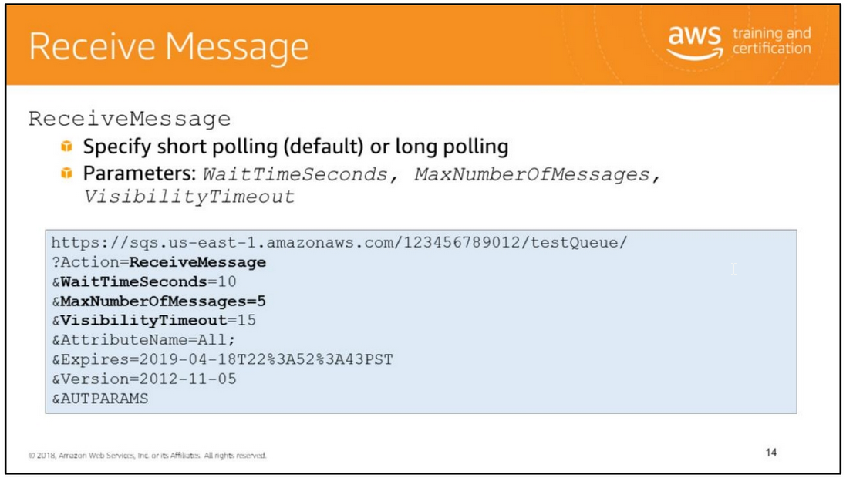

Slide 17
Now that a message is in the queue, you can receive it (retrieve it from the queue). When requesting to get a message from the queue, you cannot specify which message to get.
You simply specify the maximum number of messages you want to get (up to 10), and Amazon SQS returns up to that maximum number.
ReceiveMessage retrieves one or more messages, with a maximum limit of 10 messages, from the specified queue.
The behavior of retrieving messages from the queue depends on whether you are using short (standard) polling or long polling.
Amazon SQS short polling is the traditional and default way of retrieving messages from Amazon SQS queues.
Short polling returns a response immediately, even if the queue being polled is empty; however, long polling does not return a response until a message arrives in the queue.
These two concepts are discussed in more detail in the next couple of slides.
For more information about queue operations, see http://docs.aws.amazon.com/AWSSimpleQueueService/latest/APIReference/Welcome.html.
Visibility timeout is the period of time that a message is invisible to the rest of your application after an application component gets it from the queue.
It prevents multiple components from processing the same message.
During the visibility timeout, the component that received the message usually processes it and then deletes it from the queue.
This prevents multiple components from processing the same message.
When the application needs more time for processing, the visibility timeout can be changed dynamically via the ChangeMessageVisibility operation.
For more information about visibility timeout, see http://docs.aws.amazon.com/AWSSimpleQueueService/latest/SQSDeveloperGuide/A boutVT.html.

Slide 18
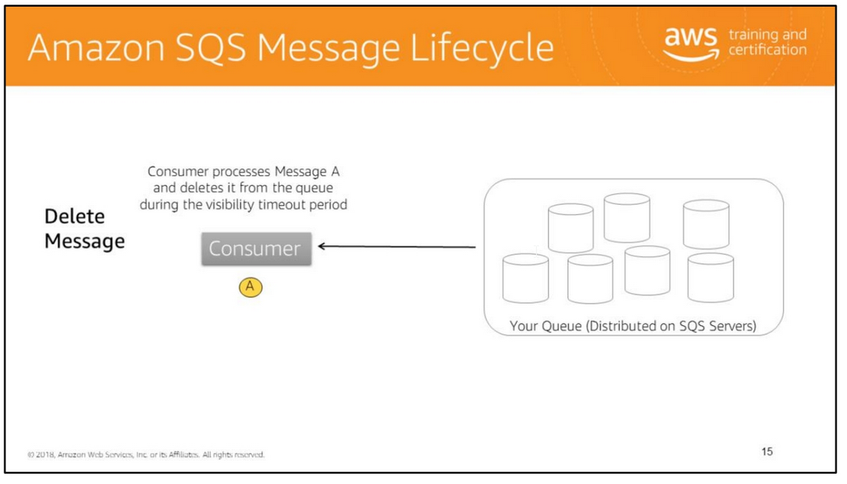
Amazon SQS automatically deletes messages that have been in a queue for more than maximum message retention period.
The default message retention period is 4 days.
However, you can set the message retention period to a value from 60 seconds to 1,209,600 seconds (14 days) using the SetQueueAttributes action.
This can also be performed with the SDK, for example Python (Boto3): response = client.delete_message( QueueUrl='string', ReceiptHandle='string )

Slide 19
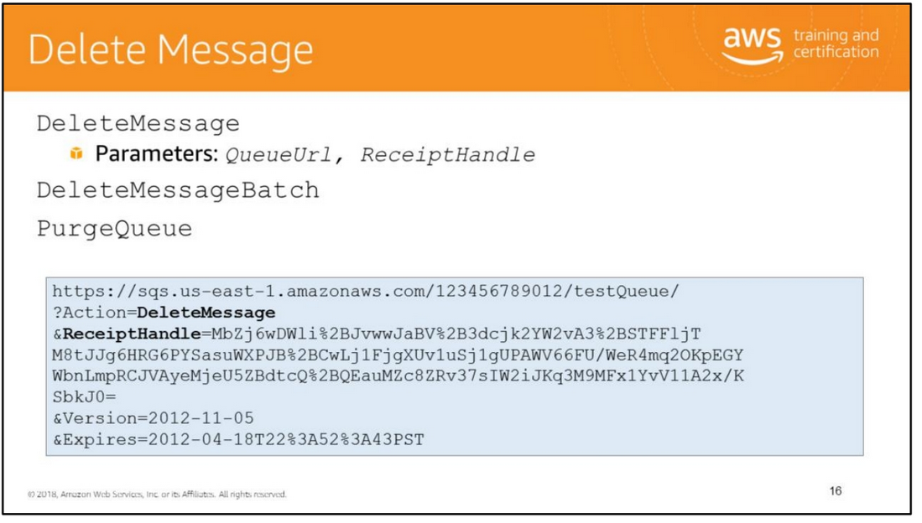
When you receive the message, you must delete it from the queue to acknowledge that you processed the message and no longer need it.
You specify which message to delete by providing the receipt handle that Amazon SQS returned when you received the message.
Amazon SQS doesn't automatically delete the message after returning it to you, in case you don't actually receive the message (the receiving component could fail or lose its connection).
You must send a separate request to delete the message, which acknowledges that you've successfully received and processed the message.
You can use the DeleteMessage request to delete the specified message from the specified queue.
Even if the message is locked by another reader because of the visibility timeout setting, it is still deleted from the queue.
If you leave a message in the queue for longer than the queue's configured retention period, Amazon SQS automatically deletes it.
There is also a batch version of this request, known as DeleteMessageBatch, that lets you delete up to 10 messages from the specified queue.
The slide illustrates an example query request that deletes a message from the queue named testQueue.
Note: You can also delete an entire queue with a call to DeleteQueue, even if the queue has messages in it.
Alternatively, you can use the PurgeQueue request to delete all the messages in an Amazon SQS queue without deleting the queue itself.

Slide 20
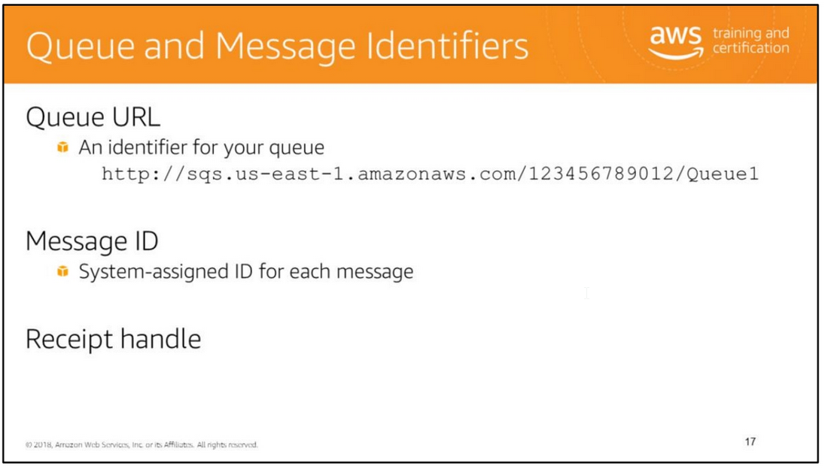
Queue URL
When creating a new queue, you must provide a queue name that is unique within the scope of all your queues.
Amazon SQS assigns each queue you create an identifier called a queue URL, which includes the queue name and other components that Amazon SQS determines.
You must provide the queue URL to perform an action on a queue.
The slide illustrates a queue URL for a queue named "queue1" owned by a person with the AWS account number "123456789012."
Note: Always use the entire queue URL as Amazon SQS returned it to you when you created the queue. Do not build the queue URL from its separate components.
Message ID
For each message, Amazon SQS returns a system-assigned message ID in the SendMessage response. This unique identifier is useful for identifying messages.
The maximum length of a message ID is 100 characters.
Receipt Handle
Each time you receive a message from a queue, you receive a receipt handle for that message.
The handle is associated with the act of receiving the message, not with the message itself.
If you receive a message more than once, each time you receive it, you get a different receipt handle. The maximum length of a receipt handle is 1024 characters.
Note: To delete a message, you need the message’s receipt handle instead of the message ID.

Slide 21
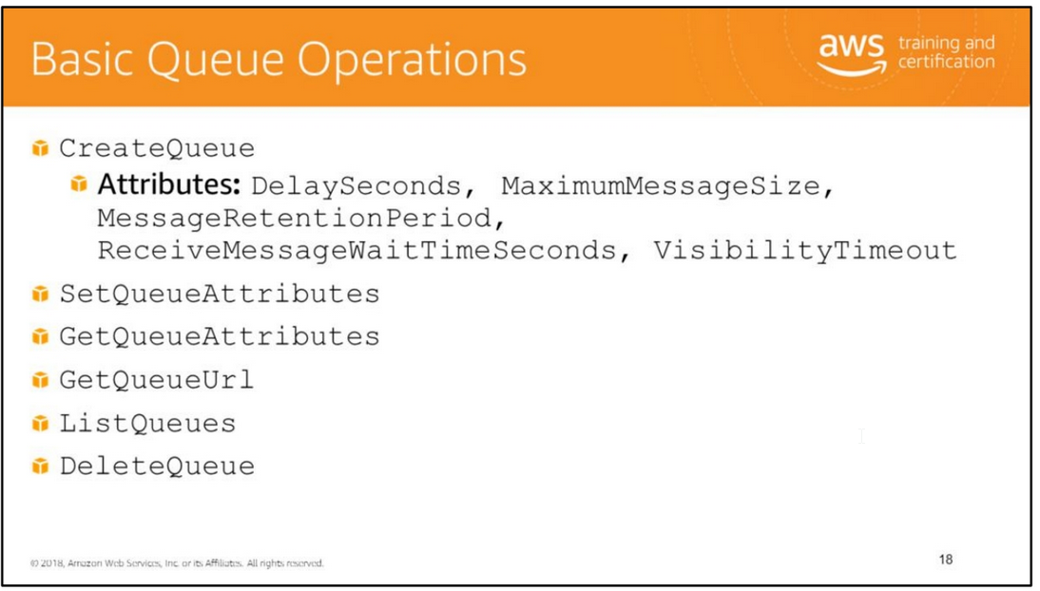
CreateQueue creates a new queue or returns the URL of an existing one. When you request CreateQueue, you provide a name for the queue.
To successfully create a new queue, you must provide a name that is unique within the scope of your own queues. You may pass one or more attributes in the request including:
• DelaySeconds: The time in seconds that the delivery of all messages in the queue will be delayed. The maximum delay is 15 minutes and the default value for this attribute is 0.
• MaximumMessageSize: The limit of how many bytes a message can contain before Amazon SQS rejects it. The maximum and default values for this attribute are 256KiB.
• MessageRetentionPeriod: The number of seconds Amazon SQS retains a message. The maximum value for this attribute is 14 days and by default a message is retained for 4 days.
• ReceiveMessageWaitTimeSeconds: The time for which a ReceiveMessage call will wait for a message to arrive. The maximum configurable wait time is 20 seconds and the default value is 0.
• VisibilityTimeout: The period of time that a message is invisible to the rest of your application after an application component gets it from the queue.
During the visibility timeout, the component that received the message usually processes it and then deletes it from the queue.
This prevents multiple components from processing the same message. The maximum allowed timeout value is 12 hours. The default timeout value is 30 seconds.
When the application needs more time for processing, you can change this timeout value dynamically via the ChangeMessageVisibility operation.
If you do not provide a value for any attribute, the queue will have the default value for that attribute.
Use the SetQueueAttributes and GetQueueAttributes operations to set and retrieve the attributes of a queue.
When you use CreateQueue, if the queue name is already in use, then the request returns the URL of the existing queue.
A much simpler way to retrieve the URL of an Amazon SQS queue is to use the GetQueueUrl request.
The DeleteQueue request deletes a queue regardless of whether the queue is empty. When a queue is deleted, any messages in the queue are no longer available.
It is important to note that Amazon SQS can delete your queue without notification if actions like SendMessage, ReceiveMessage, DeleteMessage, GetQueueAttributes, SetQueueAttributes,
AddPermission, and RemovePermissions have not been performed on the queue for 30 consecutive days.
You can use ListQueues to retrieve a list of your queues. The results lists can be filtered by using optional parameters like QueuenamePrefix.
For more information about queue operations, see http://docs.aws.amazon.com/AWSSimpleQueueService/latest/APIReference/Welcom e.html.

Slide 22
CreateQueue creates a new queue or returns the URL of an existing one. When you request CreateQueue, you provide a name for the queue.
To successfully create a new queue, you must provide a name that is unique within the scope of your own queues. You may pass one or more attributes in the request including:
• DelaySeconds: The time in seconds that the delivery of all messages in the queue will be delayed. The maximum delay is 15 minutes and the default value for this attribute is 0.
• MaximumMessageSize: The limit of how many bytes a message can contain before Amazon SQS rejects it. The maximum and default values for this attribute are 256KiB.
• MessageRetentionPeriod: The number of seconds Amazon SQS retains a message. The maximum value for this attribute is 14 days and by default a message is retained for 4 days.
• ReceiveMessageWaitTimeSeconds: The time for which a ReceiveMessage call will wait for a message to arrive. The maximum configurable wait time is 20 seconds and the default value is 0.
• VisibilityTimeout: The period of time that a message is invisible to the rest of your application after an application component gets it from the queue.
During the visibility timeout, the component that received the message usually processes it and then deletes it from the queue.
This prevents multiple components from processing the same message. The maximum allowed timeout value is 12 hours. The default timeout value is 30 seconds.
When the application needs more time for processing, you can change this timeout value dynamically via the ChangeMessageVisibility operation.
If you do not provide a value for any attribute, the queue will have the default value for that attribute.
Use the SetQueueAttributes and GetQueueAttributes operations to set and retrieve the attributes of a queue.
When you use CreateQueue, if the queue name is already in use, then the request returns the URL of the existing queue.
A much simpler way to retrieve the URL of an Amazon SQS queue is to use the GetQueueUrl request.
The DeleteQueue request deletes a queue regardless of whether the queue is empty. When a queue is deleted, any messages in the queue are no longer available.
It is important to note that Amazon SQS can delete your queue without notification if actions like SendMessage, ReceiveMessage, DeleteMessage, GetQueueAttributes, SetQueueAttributes,
AddPermission, and RemovePermissions have not been performed on the queue for 30 consecutive days.
You can use ListQueues to retrieve a list of your queues. The results lists can be filtered by using optional parameters like QueuenamePrefix.
For more information about queue operations, see http://docs.aws.amazon.com/AWSSimpleQueueService/latest/APIReference/Welcom e.html.

Slide 23
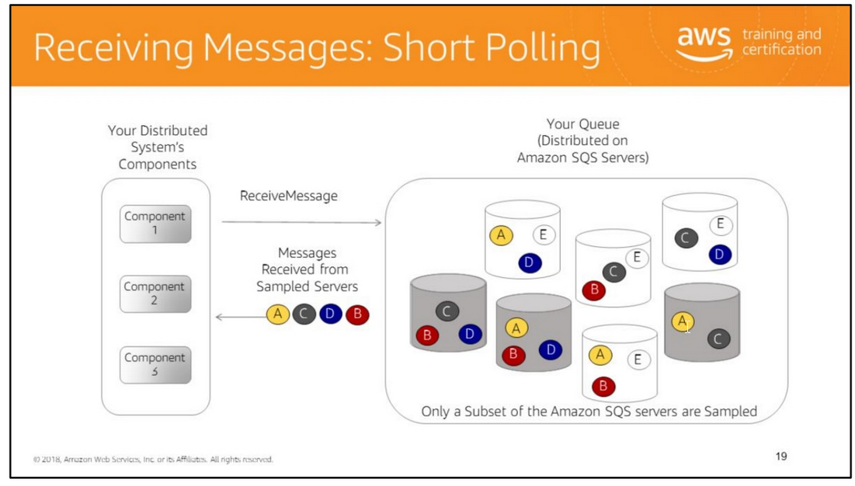
With short polling, Amazon SQS samples a subset of the servers (based on a weighted random distribution) and returns messages from only the sampled servers.
A small number of messages in the queue (less than 1000), means a particular request might not return any messages.
If you keep retrieving from your queues, Amazon SQS will sample all of the servers, and you will eventually receive all of your messages.
Short polling is the default behavior of Amazon SQS queues, and it occurs when the WaitTimeSeconds parameter of a ReceiveMessage call is set to 0
or the queue attribute ReceiveMessageWaitTimeSeconds is 0.
A better and preferred way to retrieve messages from your Amazon SQS queues is to use Amazon SQS long polling.
Though Amazon SQS long polling is preferred, if your application is written to expect an immediate response from a ReceiveMessage call,
you might not be able to take advantage of long polling without some application modifications.
For example, if your application has a single thread polling multiple queues, switching from short polling to long polling will likely not work, because the single thread will wait
for the long poll timeout on any empty queues, delaying the processing of any queues which may contain messages.
Note: For such applications, you can still take advantage of the benefits of Amazon SQS long polling by using a single thread to process only one queue.

Slide 24
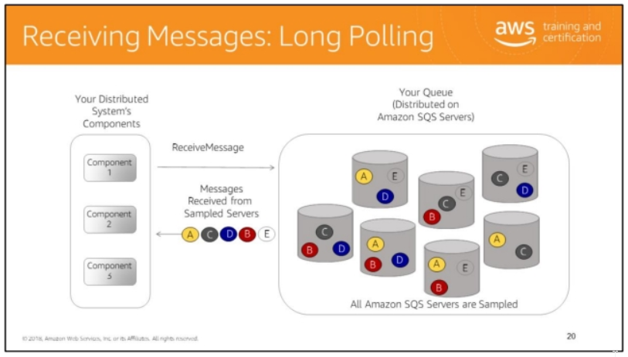
Although the traditional Amazon SQS short polling returns immediately, even if the queue being polled is empty, Amazon SQS long polling doesn’t return a response until a message arrives
in the queue or the long poll times out. Amazon SQS long polling makes it easy and inexpensive to retrieve messages from your Amazon SQS queue as soon as they are available.
With long polling, Amazon SQS queries all of the servers and waits until a message is available in the queue before sending a response.
So unless the connection times out, the response to the ReceiveMessage request will contain at least one of the available messages.
Long polling reduces the cost of using Amazon SQS by reducing the number of empty responses and false empty responses.
There are three different API action calls you can use to enable long polling in Amazon SQS: ReceiveMessage, CreateQueue, and SetQueueAttributes.
For ReceiveMessage, you configure the WaitTimeSeconds parameter, and for CreateQueue and SetQueueAttributes, you configure the ReceiveMessageWaitTimeSeconds attribute.
Important: If you decide to implement long polling with multiple queues, we recommend that you use one thread for each queue,
instead of trying to use one single thread for polling all the queues.
When you use one thread for each queue, your application can process the messages in each of the queues as they become available, as opposed to one single thread for multiple queues
where your application could be blocked from processing available messages in the other queues while waiting (up to 20 seconds) on a queue that does not have any available messages.

Slide 25
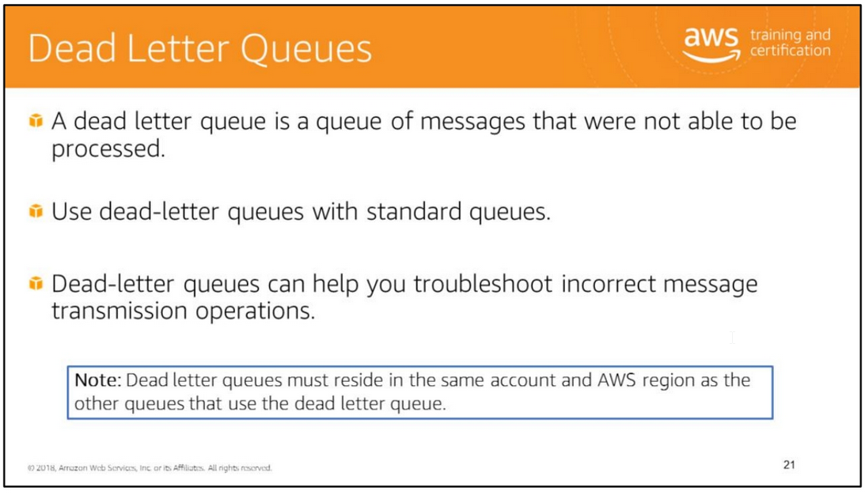
A Dead Letter Queue (DLQ) is an Amazon SQS queue which you configure to receive messages from other Amazon SQS queues, referred to as “source queues”.
Typically, you set up a DLQ to receive messages after a maximum number of processing attempts has been reached. DLQ provides the ability to isolate messages that could not be processed.
A DLQ is just like any other Amazon SQS queue. Messages can be sent to it and received from it like any other Amazon SQS queues.
You can create a DLQ from the Amazon SQS API and the Amazon SQS area in the AWS Management Console.
For more information about Amazon SQS Dead Letter Queues,
see http://docs.aws.amazon.com/AWSSimpleQueueService/latest/SQSDeveloperGuide/S QSDeadLetterQueue.html.

Slide 26
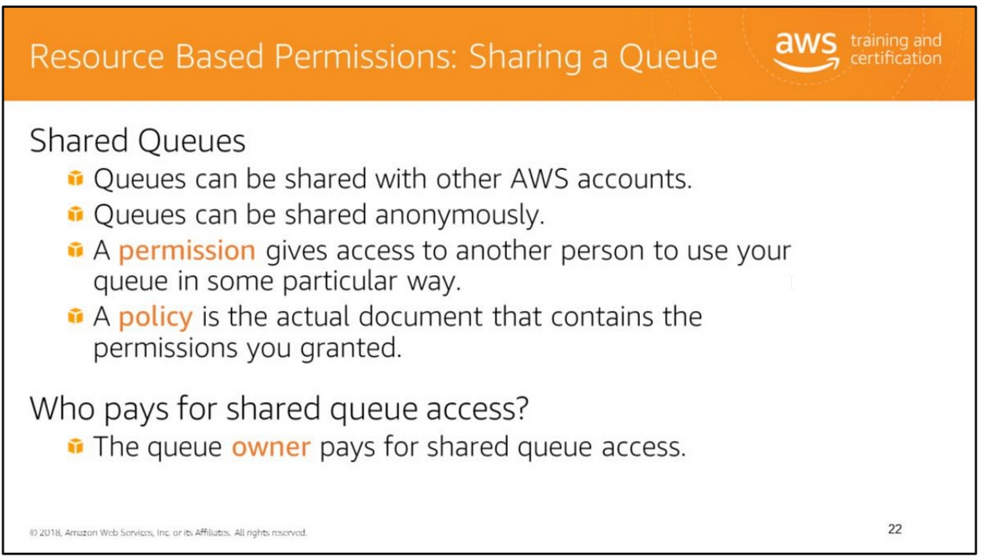
A developer associates an access policy statement (specifying the permissions being granted) with the queue to be shared.
Amazon SQS provides APIs to create and manage the access policy statements: AddPermission, RemovePermission, SetQueueAttributes, and GetQueueAttributes.
Refer to the latest API specification for more details.
Amazon SQS in each region is totally independent in message stores and queue names; therefore, the messages cannot be shared between queues in different regions.

Slide 27
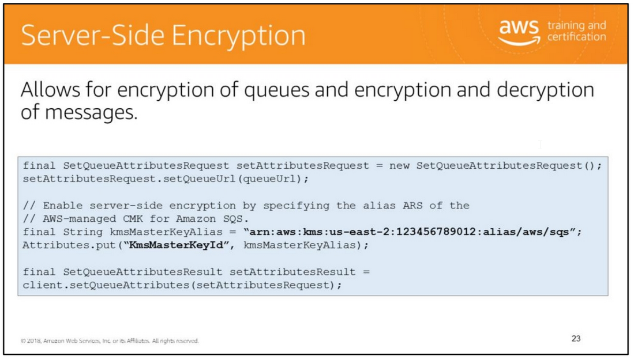
Server-side encryption (SSE) encrypts the body of the message, but does not touch the queue metadata, the message metadata, or the per-queue metrics.
Adding encryption to an existing queue does not encrypt any backlogged messages. Similarly, removing encryption leaves backlogged messages encrypted.
You can use the AWS-managed Customer Master Key (CMK) which is unique for each customer and region, or you can create and manage your own keys.
If you choose to use your own keys, don’t forget to update your KMS key policies so that they allow for encryption and decryption of messages.
Encryption key provided by AWS Key Management Service (KMS) key policies. Verify the key policies of the customer master key (CMK) allow the necessary permissions for the principal.
To send messages, the producer must have the kms:GenerateDataKey and kms:Decrypt permissions.
To receive messages, the consumer must have the kms:Decrypt permission.
For more information, see
https://docs.aws.amazon.com/AWSSimpleQueueService/latest/SQSDeveloperGuide/ sqs-server-side-encryption.html#sqs-what-permissions-for-sse

Slide 28
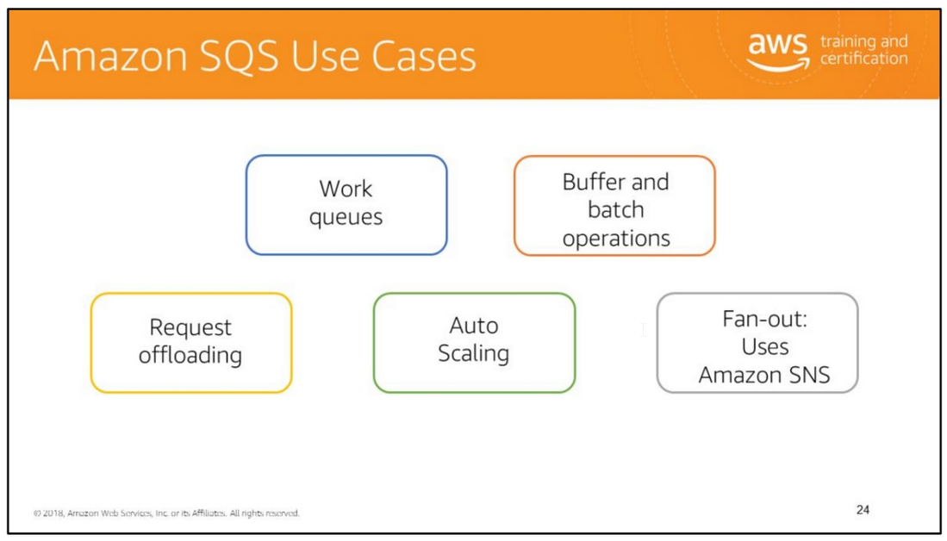
Work queues
Decouple components of a distributed application that may not all process the same amount of work simultaneously.
Buffer and batch operations
Add scalability and reliability to your architecture and smooth out temporary volume spikes without losing messages or increasing latency.
Request offloading Move slow operations off of interactive request paths by enqueuing the request.
Auto Scaling
You can use Amazon SQS queues to help determine the load on an application, and when combined with Auto Scaling, you can scale the number of Amazon EC2 instances out or in,
depending on the volume of traffic.
Fan-out Combine
Amazon SQS with Amazon SNS to send identical copies of a message to multiple queues in parallel for simultaneous processing.

Slide 29
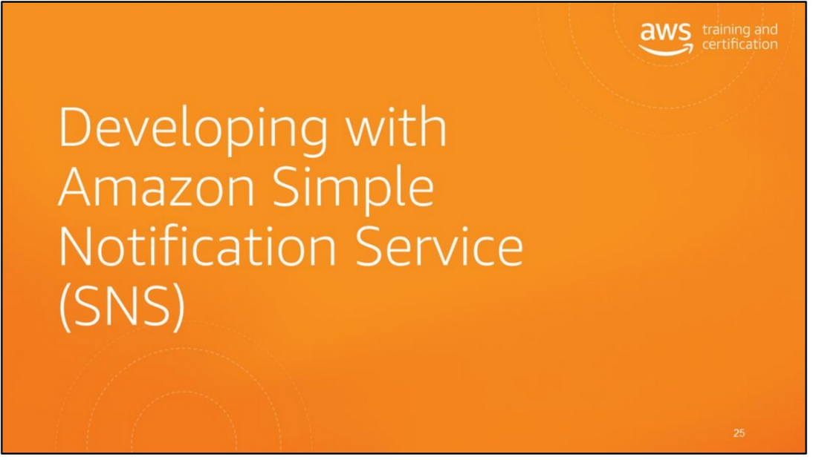

Slide 30
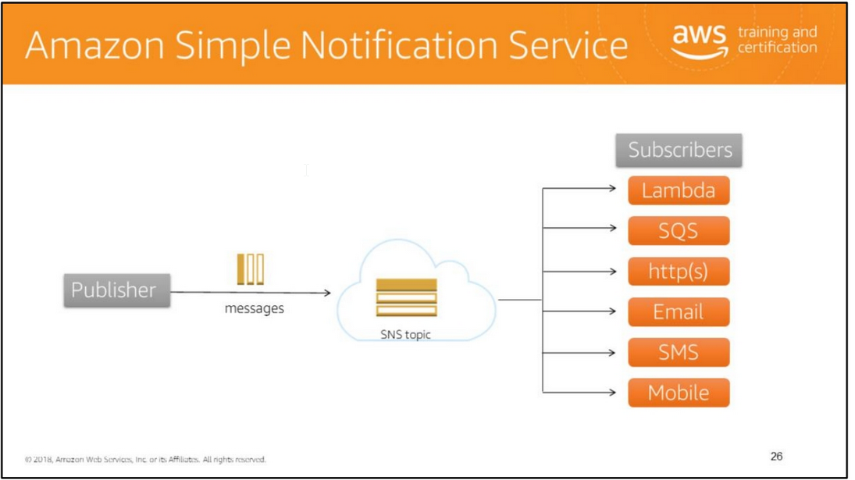

Slide 31
Amazon Simple Notification Service is a web service that makes it easy to set up, operate, and send notifications from the cloud.
Amazon SNS follows the “publish-subscribe” (pub-sub) messaging paradigm, with notifications being delivered to clients using a “push” mechanism that eliminates the need to periodically
check or “poll” for new information and updates.
When using Amazon SNS, you (as the owner) create a topic and control access to it by defining policies that determine which publishers and subscribers can communicate with the topic.
A publisher sends messages to topics they have created or to topics they have permission to publish to.
Instead of including a specific destination address in each message, a publisher sends a message to the topic.
Amazon SNS matches the topic to a list of subscribers who have subscribed to that topic and delivers the message to each of those subscribers.
Each topic has a unique name that identifies the Amazon SNS endpoint for publishers to post messages and subscribers to register for notifications.
Subscribers receive all messages published to the topics that they subscribe to, and all subscribers to a topic receive the same messages.
Subscribers (i.e., web servers, email addresses, Amazon SQS queues, AWS Lambda functions) consume or receive the message or notification over one of the supported protocols
(i.e., Amazon SQS, HTTP/S, email, SMS, Lambda) when they are subscribed to the topic.
Mobile Push Messaging Amazon
SNS lets you push messages to mobile devices or distributed services via API or an easy-to-use management console.
You can seamlessly scale from a handful of messages per day to millions of messages or more.
With Amazon SNS you can publish a message once and deliver it one or more times.
So you can choose to direct unique messages to individual Apple, Google or Amazon devices, or broadcast deliveries to many mobile devices with a single publish request.
Amazon SNS allows you to group multiple recipients using topics.
A topic is an “access point” for allowing recipients to dynamically subscribe for identical copies of the same notification.
One topic can support deliveries to multiple endpoint types; for example, you can group together iOS, Android and SMS recipients.
When you publish once to a topic, Amazon SNS delivers appropriately formatted copies of your message to each subscriber.

Slide 32
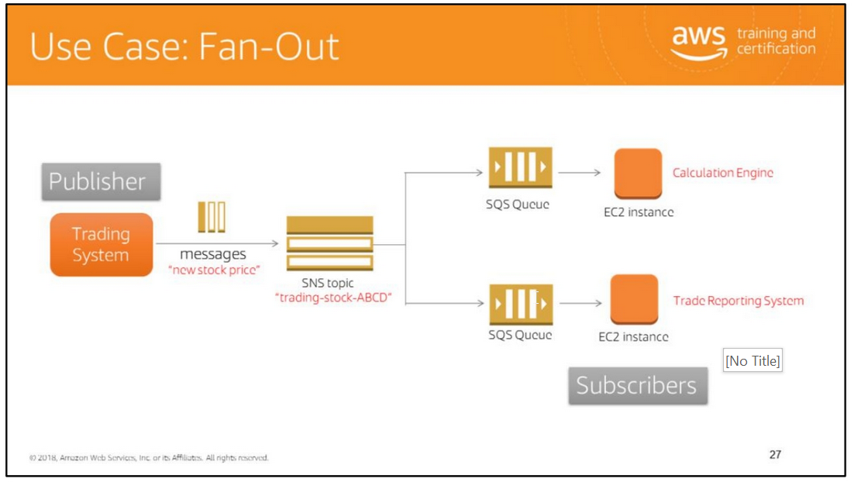
To have Amazon SNS deliver notifications to an SQS queue, a developer should subscribe to a topic specifying “SQS” as the transport and a valid SQS queue as the end point.
In order to allow the SQS queue to receive notifications from Amazon SNS, the SQS queue owner must subscribe the SQS queue to the topic for Amazon SNS.
If the user owns both the Amazon SNS topic being subscribed to and the SQS queue receiving the notifications, nothing further is required.
Any message published to the topic will automatically be delivered to the specified SQS queue.
If the owner of the SQS queue is not the owner of the topic, Amazon SNS will require an explicit confirmation to the subscription request.
The slide illustrates an example of a fan-out scenario using SNS and SQS.
In a fan-out scenario, an Amazon SNS message is sent to a topic and then replicated and pushed to multiple Amazon SQS queues, HTTP endpoints, or email addresses.
This allows for parallel asynchronous processing. For example, you could develop an application that sends an Amazon SNS message to a topic whenever an order is placed for a product.
Then, the Amazon SQS queues that are subscribed to that topic would receive identical notifications for the new order.
The Amazon EC2 server instance attached to one of the queues could handle the processing or fulfillment of the order, while the other server instance could be attached to a data warehouse
for analysis of all orders received.

Slide 33
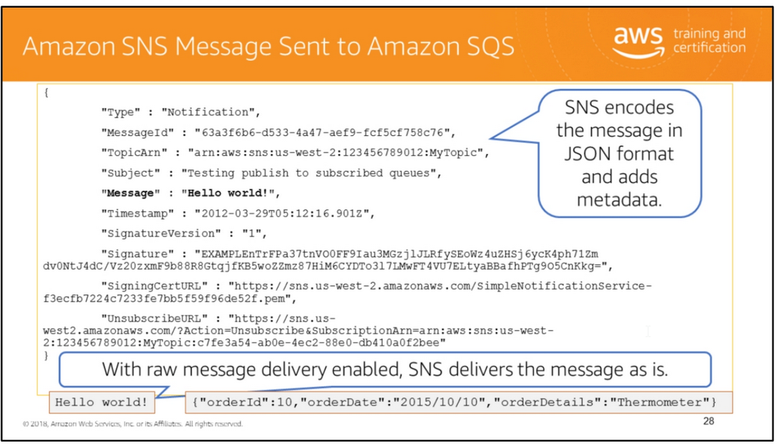
By default, when Amazon SNS sends a message to Amazon SQS, it encodes the message as a JSON document that contains the message as well as metadata about the message.
If you enable raw message delivery on a subscription, Amazon SNS sends messages as is without adding JSON encoding or Amazon SNS metadata.
Note that in the example containing order information, the original producer sent a JSON-formatted order message to Amazon SNS.
Amazon SNS then simply published the message as is to subscribers without adding Amazon SNS metadata.
For more information, see:
• Sending Amazon SNS Messages to Amazon SQS Queues: http://docs.aws.amazon.com/sns/latest/dg/SendMessageToSQS.html#SendMessageToS QS.test

Slide 34
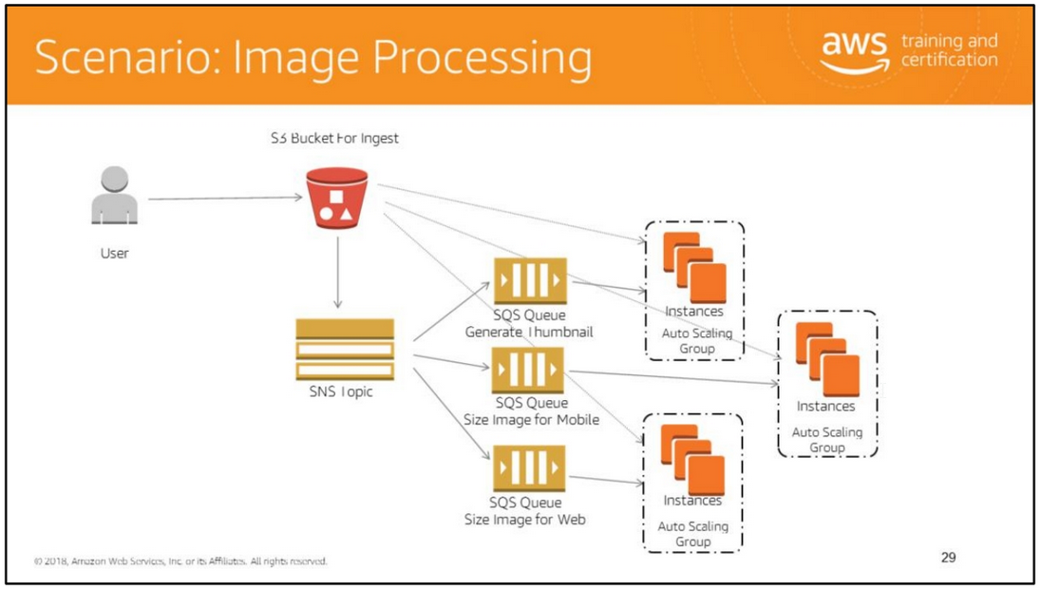
The slide illustrates another example of the fan-out use case for an image processing scenario where a fleet of servers picks up messages from the generate thumbnail queue and processes them.
Similarly, there is a fleet of servers to size images for mobile and another fleet of servers to size images for web.
Then the processed images get uploaded to an Amazon S3 bucket (Reduced Redundancy Storage bucket) to make them available for CloudFront to retrieve.
An alternative option for this scenario is to use Amazon S3 Event Notifications instead of Amazon SNS.
Amazon S3 Event Notifications can communicate directly with Amazon SQS. You could also integrate this with AWS Lambda, which is discussed on the next slide.
You could also use Amazon DynamoDB in this architecture to store metadata and other information from the application layer.

Slide 35
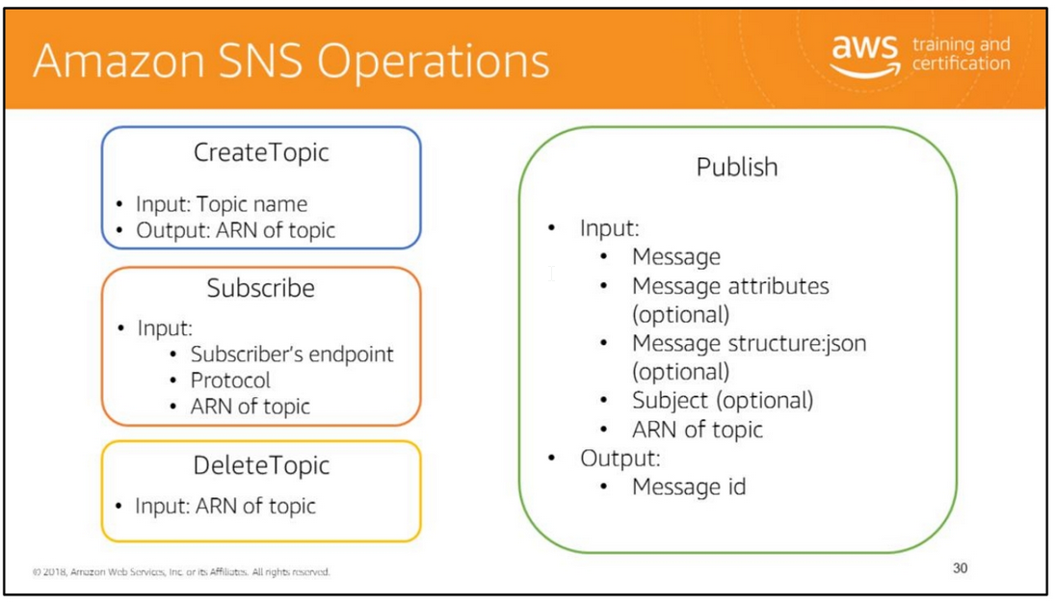
The CreateTopic request creates a topic to which notifications can be published. Users can create a maximum of 3000 topics.
This action is idempotent, so if the requester already owns a topic with the specified name, that topic's ARN is returned without creating a new topic.
The response from the CreateTopic request contains the Amazon Resource Name (ARN) of the created topic.
The Subscribe request prepares to subscribe an endpoint by sending the endpoint a confirmation message.
To actually create a subscription, the endpoint owner must call the ConfirmSubscription action with the token from the confirmation message.
Confirmation tokens are valid for three days. The response of the Subscribe request includes the ARN of the subscription, if the service was able to create a subscription immediately
(without requiring endpoint owner confirmation).
The ConfirmSubscription request verifies an endpoint owner's intent to receive messages by validating the token sent to the endpoint by an earlier Subscribe action.
If the token is valid, the action creates a new subscription and returns its ARN. This call requires an AWS signature only when the AuthenticateOnUnsubscribe flag is set to "true“.
The DeleteTopic request deletes a topic and all its subscriptions. Deleting a topic might prevent some messages previously sent to the topic from being delivered to subscribers.
This action is idempotent, so deleting a topic that does not exist does not result in an error. Publish sends a message to all of a topic's subscribed endpoints.
When a messageId is returned, the message has been saved and Amazon SNS will attempt to deliver it to the topic's subscribers shortly.
The format of the outgoing message to each subscribed endpoint depends on the notification protocol selected.
For a complete list of actions, see http://docs.aws.amazon.com/sns/latest/api/API_Operations.html.

Slide 36
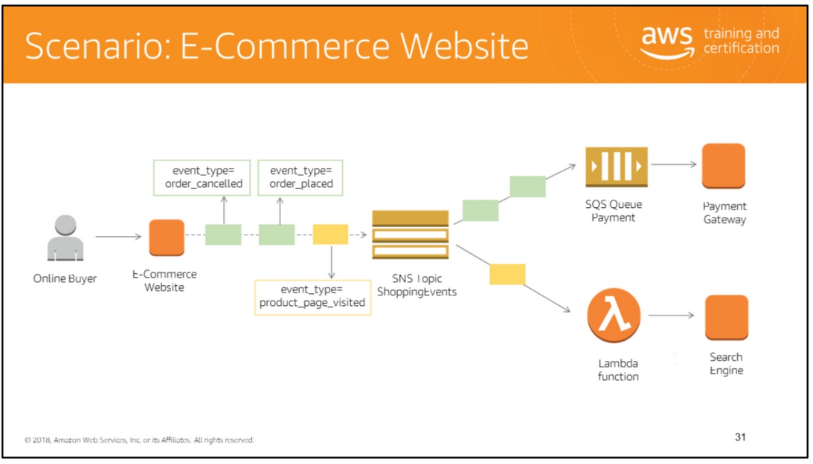
Amazon SNS and AWS Lambda are integrated so you can invoke Lambda functions with Amazon SNS notifications.
When a message is published to an SNS topic that has a Lambda function subscribed to it, the Lambda function is invoked with the payload of the published message.
The Lambda function receives the message payload as an input parameter and can manipulate the information in the message, publish the message to other SNS topics,
or send the message to other AWS services.
By default, a subscriber of an Amazon SNS topic receives every message published to the topic.
To receive only a subset of the messages, a subscriber assigns a filter policy to the topic subscription.
This feature simplifies the pub/sub messaging architecture by offloading the filtering logic from subscribers, as well as the routing logic from publishers, to SNS.
Amazon SNS message filtering now supports both numeric and string matching. Specifically, string matching operators allow for exact, prefix, and “anything-but” comparisons,
while numeric matching operators allow for exact and range comparisons. You can leverage this new set of operators to further simplify pub/sub messaging architectures
by offloading to SNS message filtering logic from subscribers, as well as routing logic from publishers.
Create topic
2. Assigns a filter policy to the topic subscription

Slide 37
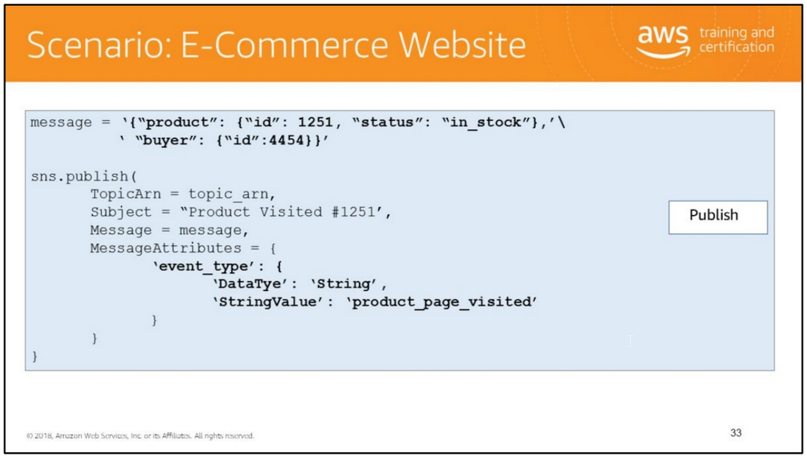
The message attribute “event_type” with the value “product_page_visited” matches only the filter policy associated with the search engine subscription.
Therefore, only the Lambda function subscribed to the SNS topic is notified about this navigation event

Slide 38
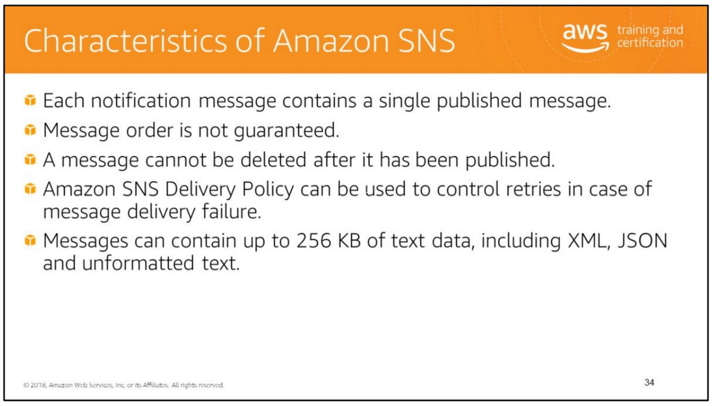
For more information, see https://aws.amazon.com/sns/faqs/.

Slide 39
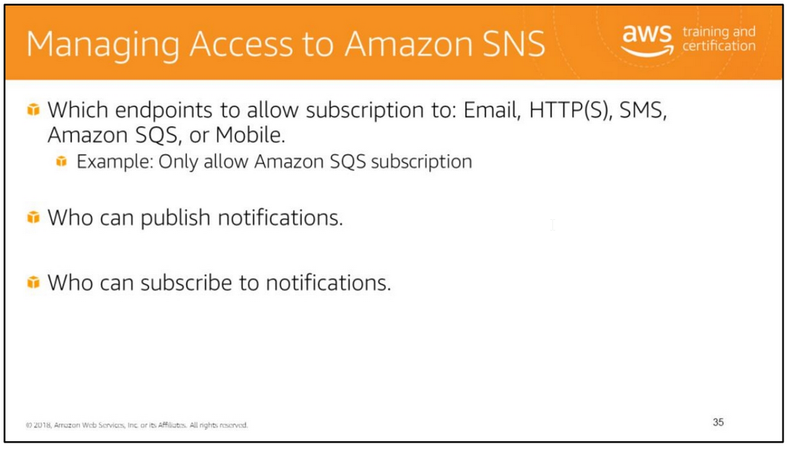
Amazon SNS supports other protocols beside email. You can use HTTP, HTTPS, and Amazon SQS queues.
You have detailed control over which endpoints a topic allows, who is able to publish to a topic, and under what conditions.
Amazon SNS integrates with AWS Identity and Access Management (IAM) so that you specify which Amazon SNS actions a user in your AWS account can perform with Amazon SNS resources.
You can specify a particular topic in the policy.
For example, you could use variables when creating an IAM policy that gives certain users in your organization permission to use the Publish action with specific topics in your AWS account.
You use an IAM policy to restrict your users' access to Amazon SNS actions and topics. An IAM policy can restrict access only to users within your AWS account, not to other AWS accounts.
You use an Amazon SNS policy with a particular topic to restrict who can work with that topic (for example, who can publish messages to it, who can subscribe to it). Amazon SNS policies can give access to other AWS accounts, or to users within your own AWS account.

Slide 40
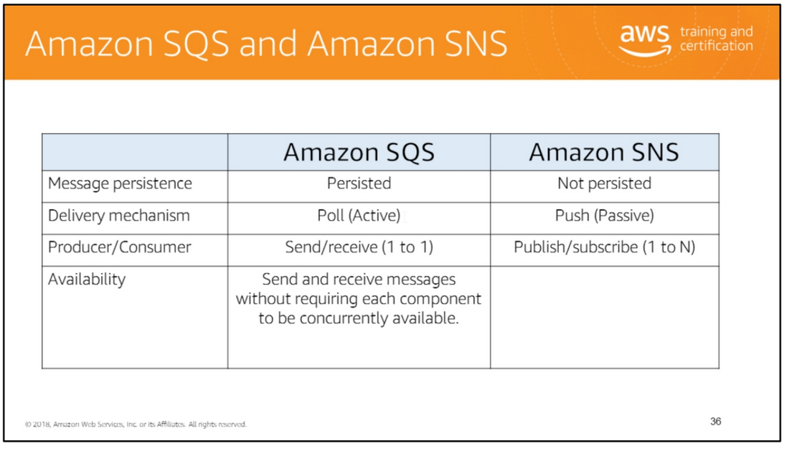
Amazon SQS and Amazon SNS are both messaging services within AWS, but they provide different benefits for developers.
Amazon SNS allows applications to send time-critical messages to multiple subscribers through a “push” mechanism, eliminating the need to periodically check or “poll” for updates.
Amazon SQS is a message queue service used by distributed applications to exchange messages through a polling model, and it can be used to decouple sending and receiving components.
Amazon SQS provides flexibility for distributed components of applications to send and receive messages without requiring each component to be concurrently available.

Slide 41
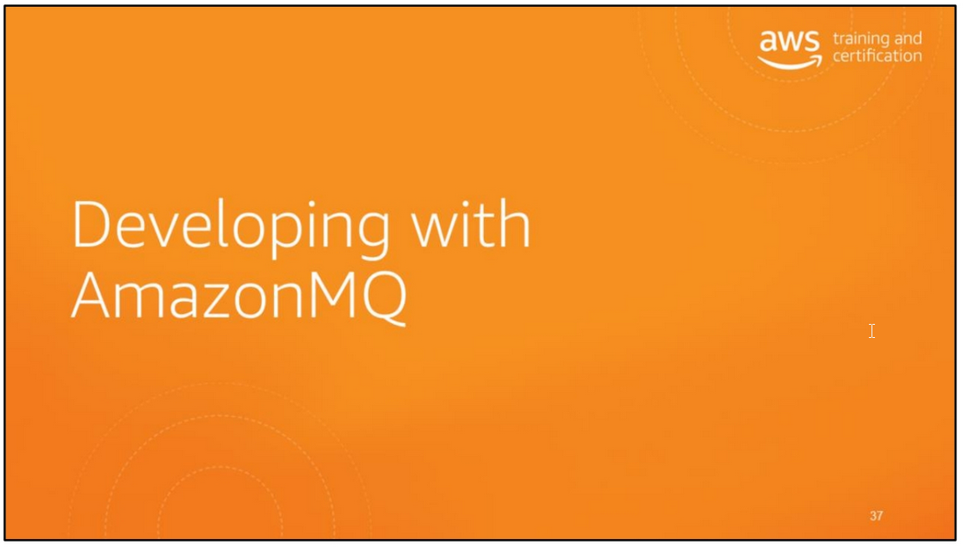

Slide 42
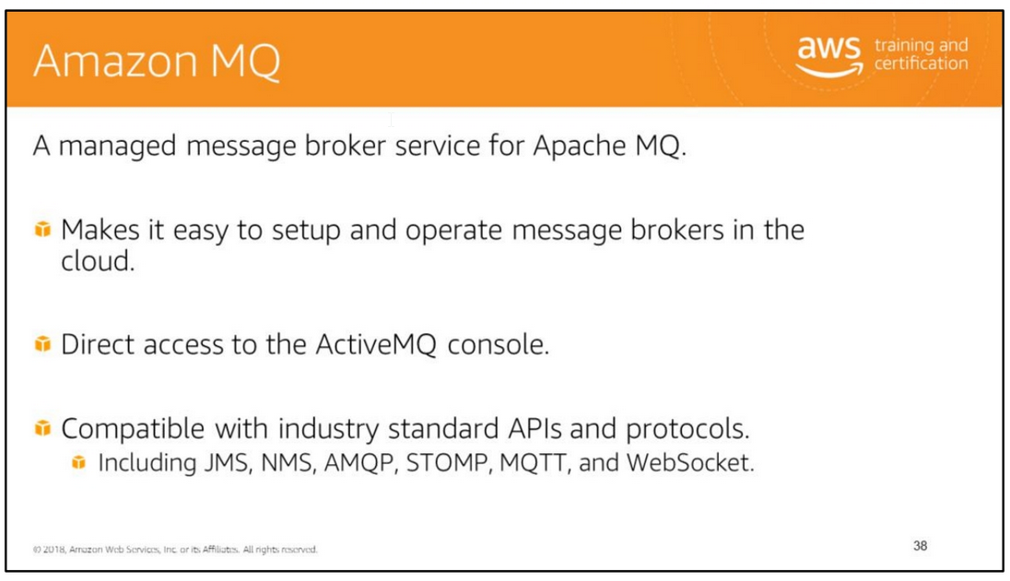
Amazon MQ is a managed message broker service for Apache ActiveMQ that makes it easy to set up and operate message brokers in the cloud. Message brokers allow different software systems
–often using different programming languages, and on different platforms–to communicate and exchange information.
Messaging is the communications backbone that connects and integrates the components of distributed applications, such as order processing, inventory management,
and order fulfillment for e-commerce. Amazon MQ manages the administration and maintenance of ActiveMQ, a popular open-source message broker.
The underlying infrastructure is automatically provisioned for high availability and message durability to support the reliability of your applications.
With Amazon MQ, you get direct access to the ActiveMQ console and industry standard APIs and protocols for messaging, including JMS, NMS, AMQP, STOMP, MQTT, and WebSocket.
You can easily move from any message broker that uses these standards to Amazon MQ because you don’t have to rewrite any messaging code in your applications.

Slide 43
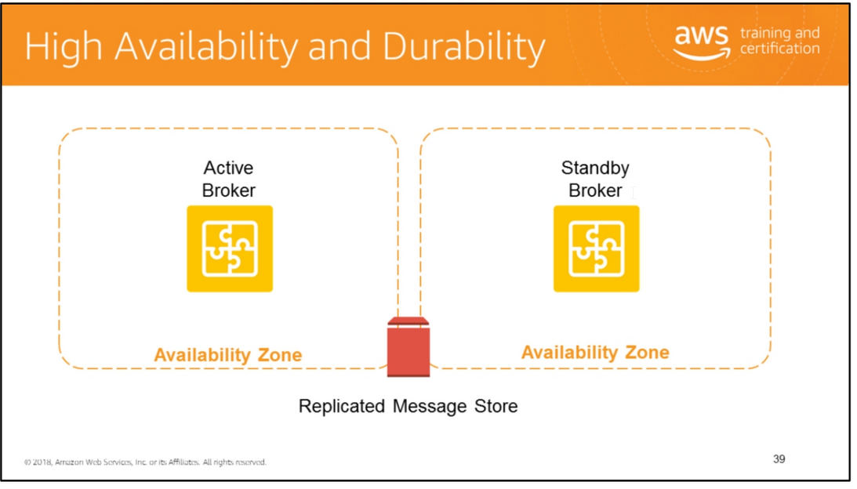
An active/standby broker for high availability is comprised of two brokers in two different Availability Zones, configured in a redundant pair.
These brokers communicate synchronously with your application, and with a shared storage location.
Normally, only one of the broker instances is active at any time, while the other broker instance is on standby.
If one of the broker instances malfunctions or undergoes maintenance, it takes Amazon MQ a short while to take the inactive instance out of service,
allowing the healthy standby instance to become active and to begin accepting incoming communications.
Amazon MQ brokers can be created as single-instance brokers or active/standby brokers for high availability.
For both deployment modes, Amazon MQ provides high durability by storing its data redundantly, across multiple Availability Zones (multi-AZs) within an AWS Region.
Amazon MQ ensures high availability by providing failover to a standby instance in a second Availability Zone.

Slide 44
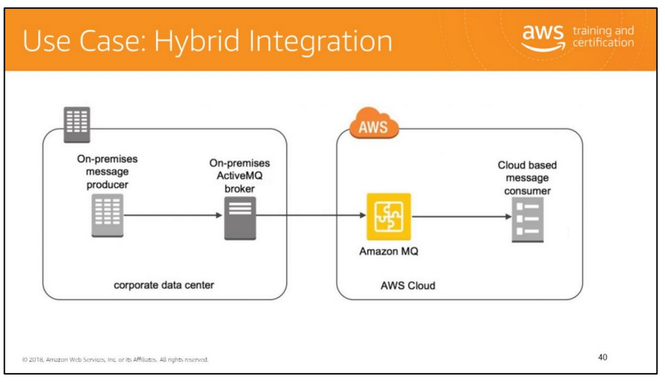
Organizations have started to build new or “lift and shift” applications to AWS. In some cases, there are applications, such as mainframe systems, too costly to migrate.
In these scenarios, those on-premises applications still need to interact with cloud-based components.
Amazon MQ is a managed message broker service for ActiveMQ that enables organizations to send messages between applications in the cloud and on-premises
to enable hybrid environments and application modernization.
ActiveMQ is an open-source message broker written in Java that is packaged with clients in multiple languages, Java Message Server (JMS) client being one example.
This diagram shows you can use Amazon MQ to integrate on-premises and cloud environments using the network of brokers feature of ActiveMQ.
It outlines the message lifecycle from the on-premises producer to the on-premises broker, traversing the hybrid connection between the on-premises broker and Amazon MQ,
and finally consumption within the AWS Cloud.
For more information, see https://aws.amazon.com/blogs/compute/running-activemq-in-a-hybrid-cloud-environment-with-amazon-mq/.

Slide 45
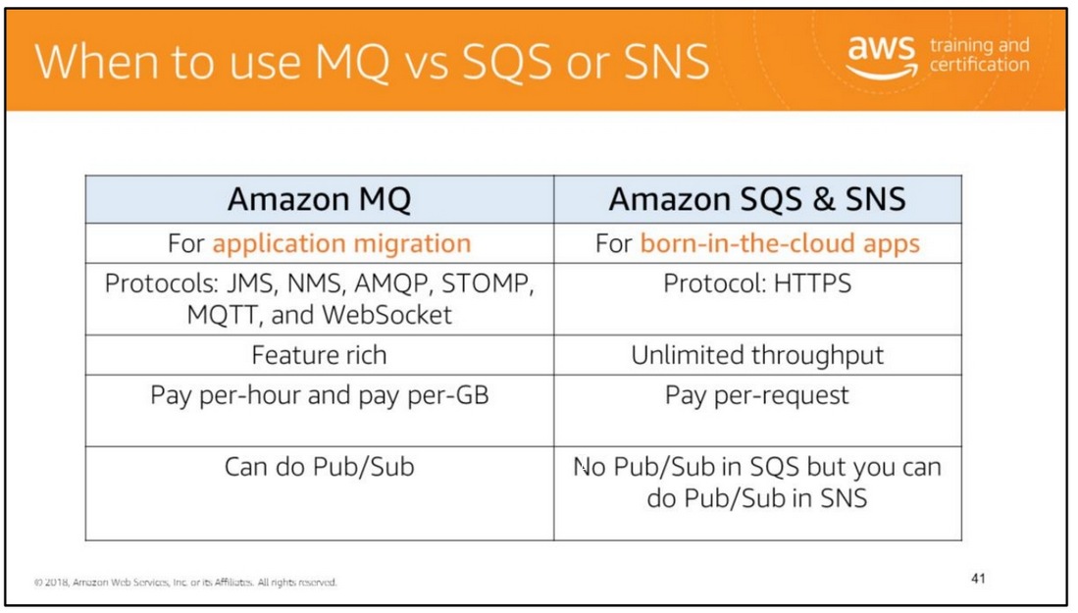
Amazon MQ, Amazon SQS, and Amazon SNS are messaging services that are suitable for anyone from startups to enterprises.
If you're using messaging with existing applications, and want to move your messaging to the cloud quickly and easily, we recommend you consider Amazon MQ.
It supports industry-standard APIs and protocols so you can switch from any standards-based message broker to Amazon MQ without rewriting the messaging code in your applications.
If you are building brand new applications in the cloud, we recommend you consider Amazon SQS and Amazon SNS.
Amazon SQS and SNS are lightweight, fully managed message queue and topic services that scale almost infinitely and provide simple, easy-to-use APIs.
You can use Amazon SQS and SNS to decouple and scale microservices, distributed systems, and serverless applications, and improve reliability.

Slide 46

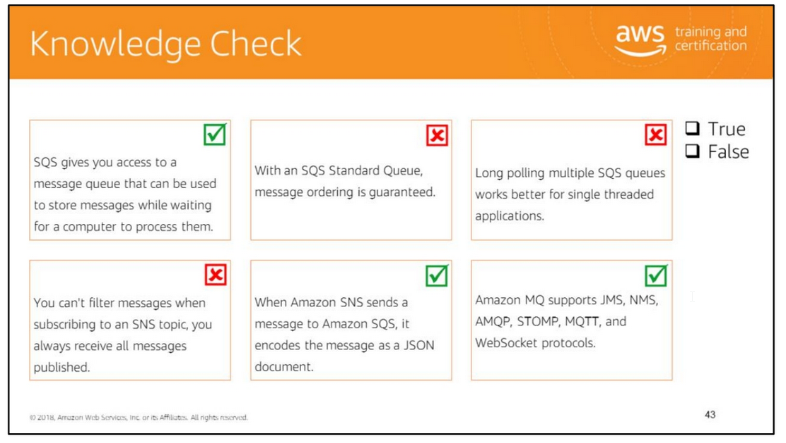
Read left to right:
(True)
(False) With an SQS Standard Queue, message ordering is not guaranteed. Message order is preserved with a FIFO Queue. (False) With long polling, does not work better for single threaded applications.
If you decide to implement long polling with multiple queues, we recommend that you use one thread for each queue, instead of trying to use one single thread for polling all the queues.
When you use one thread for each queue, your application can process the messages in each of the queues as they become available, as opposed to one single thread for multiple queues where your application
could be blocked from processing available messages in the other queues while waiting (up to 20 seconds) on a queue that does not have any available messages.
(False) You can filter messages when subscribing to an SNS topic, you always receive all messages published.
(True)
(True)

Slide 47
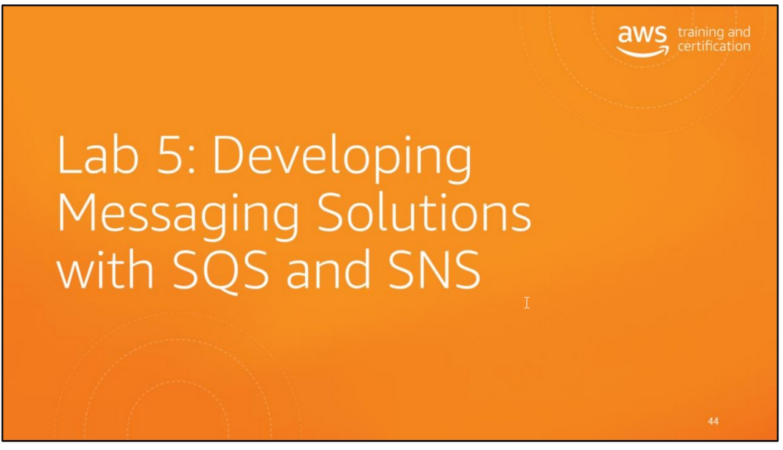
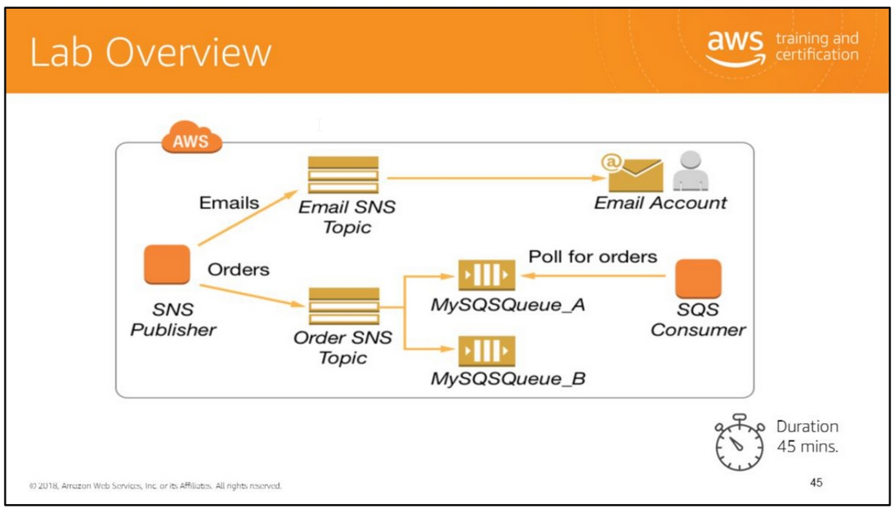
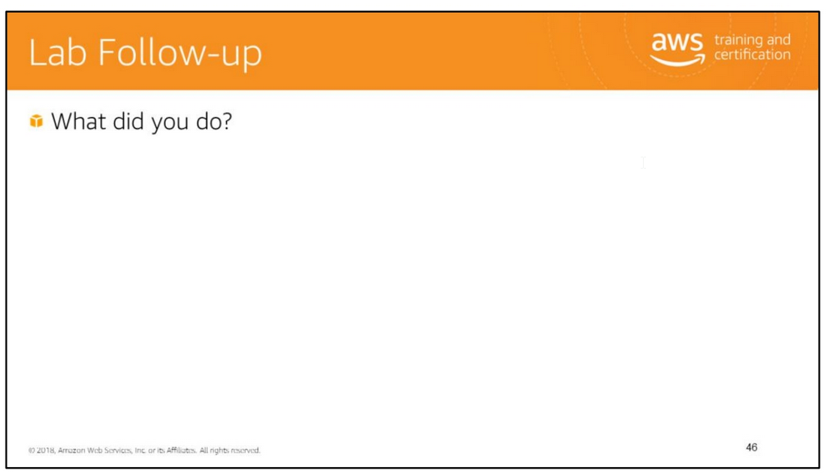
Amazon Simple Notification Service (SNS) and Amazon Simple Queue Service (SQS).
You will learn how to set up Amazon SNS and Amazon SQS to implement a fan-out scenario
to send messages to multiple recipients.
In the lab, you will:
• Set up Amazon SNS topics and Amazon SQS queues.
• Develop the Amazon SNS publisher.
• Develop the Amazon SQS consumer.

Slide 48
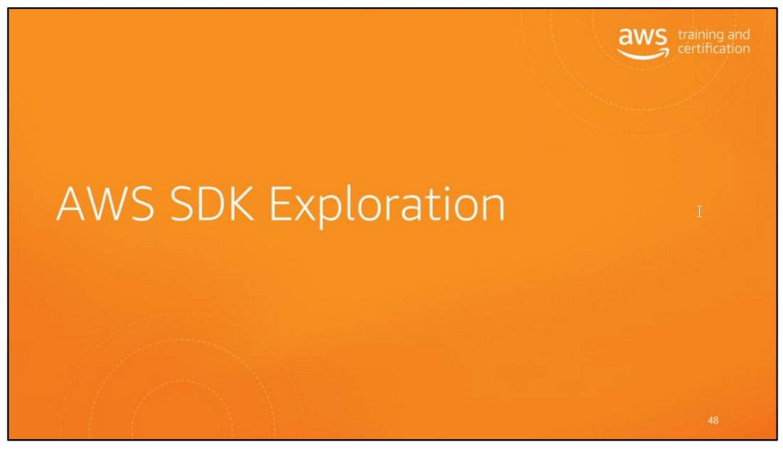

Slide 49
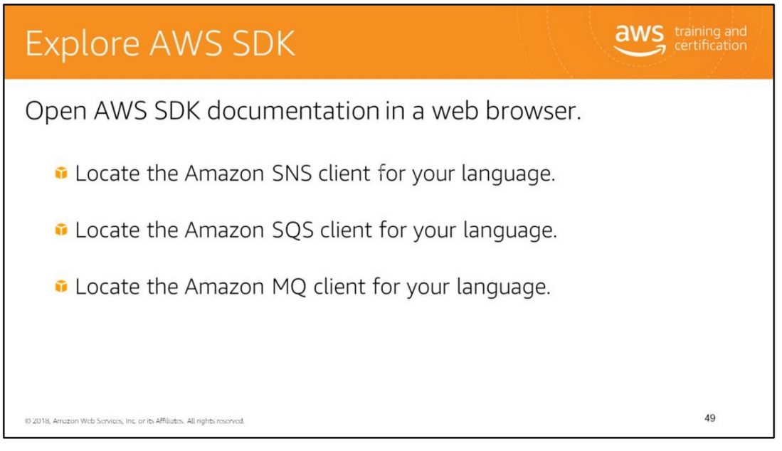
Familiarize yourself with the Amazon SNS, Amazon SQS, and Amazon MQ related API in the SDK for your preferred language.
Java
• Amazon SNS client: http://docs.aws.amazon.com/AWSJavaSDK/latest/javadoc/com/amazonaws/services/sns /AmazonSNSClient.html
• Amazon SQS client: http://docs.aws.amazon.com/AWSJavaSDK/latest/javadoc/com/amazonaws/services/sqs /AmazonSQSClient.html
• Amazon MQ Interface: http://docs.aws.amazon.com/AWSJavaSDK/latest/javadoc/com/amazonaws/services/mq /AmazonMQClient.html
http://docs.aws.amazon.com/sdkfornet/v3/apidocs/items/MQ/TMQClient.html Python
• Amazon SNS client: http://boto3.readthedocs.org/en/latest/reference/services/sns.html
• Amazon SQS client: http://boto3.readthedocs.org/en/latest/reference/services/sqs.html
• Amazon MQ client: http://boto3.readthedocs.org/en/latest/reference/services/mq.html

Slide 50
